Slide 1

Patron Last Activity Date Updated at Login
Yoel Kortick | June 2026

Slide 2
Agenda
Introduction
Configuring to use the Patron Last Activity Date
Let's see it live

Slide 3
Introduction

Slide 4
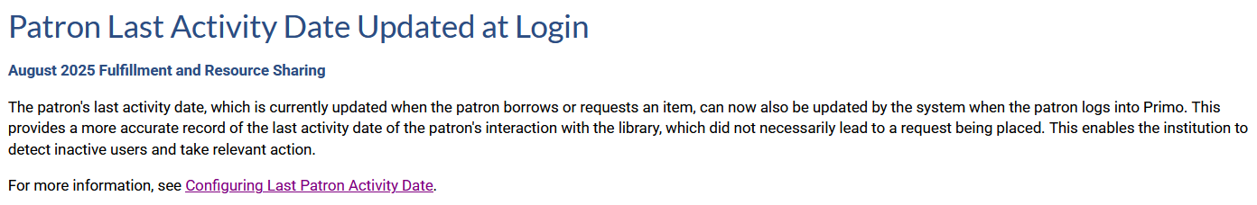
Introduction

Slide 5
Introduction
Until this development, the patron's last activity date would get updated when the patron places a request, borrows or returns an item.
Now the patron's last activity date will also be updated by the system when the patron logs into Primo.
In this manner, Alma provides a more accurate record of the last activity date of the patron's interaction with the library. This is the case even if an item was not borrowed or requested.
This enables the institution to detect inactive users and take relevant action.

Slide 6
Configuring to use the Patron Last Activity Date

Slide 7
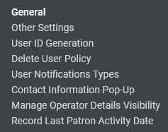
Configuring to use the Patron Last Activity Date
Access the "Patron Last Activity Date" at "Configuration > User Management > General > Record Last Patron Activity Date" configuration at Configuration Menu > User Management > General > Record Last Patron Activity Date"

Slide 8
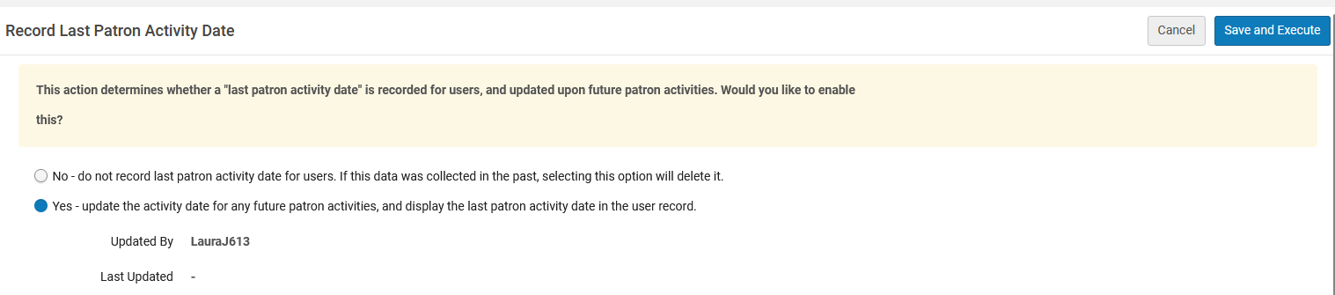
Configuring to use the Patron Last Activity Date
In order to use the Patron last Activity Date, select "Yes – update activity date for any future activities, and display the last patron activity date in the user record"

Slide 9
Let's see it live

Slide 10
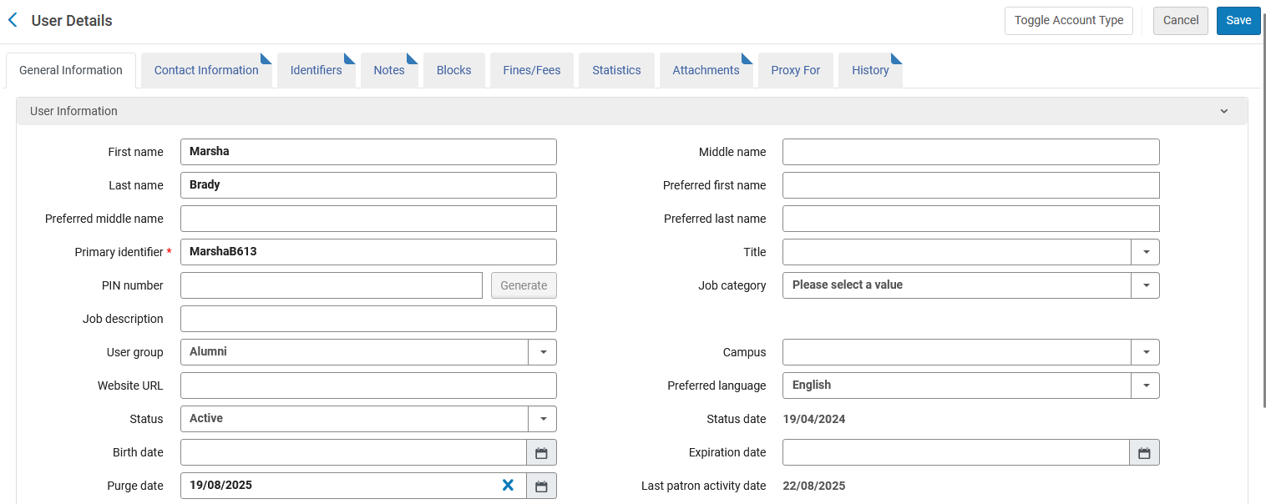
Let's see it live
Currently the Patron Last Activity Date for patron "Marsha Brady" is Aug. 22, 2025

Slide 11
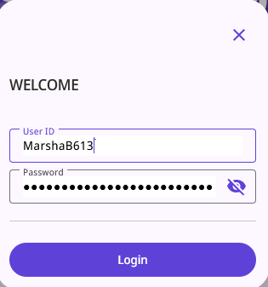
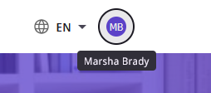
Let's see it live
On May 11, 2026, Marsha Brady logs into Primo

Slide 12

Let's see it live
And instantaneously, after she logs into Primo, the Patron Last Activity Date is updated in Alma

Slide 13
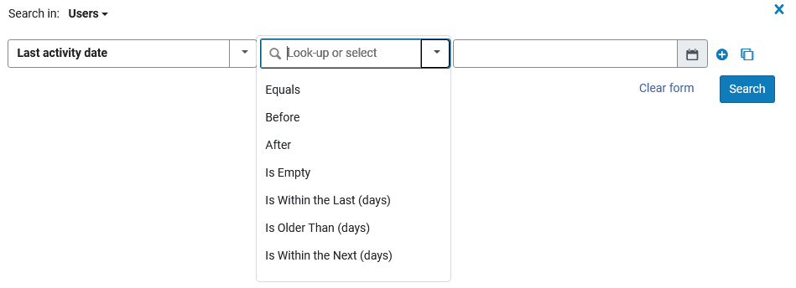
Let's see it live
Note that it is also possible to retrieve patrons in Alma via the Patron Last Activity Date

Slide 14
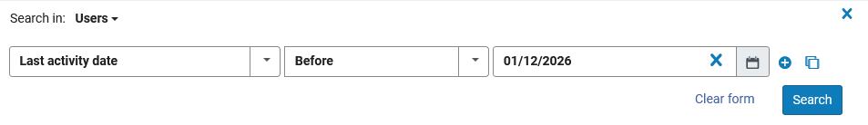
Let's see it live
Here for example, we will search for all patrons with a Patron Last Activity Date before Jan. 1, 2026

Slide 15
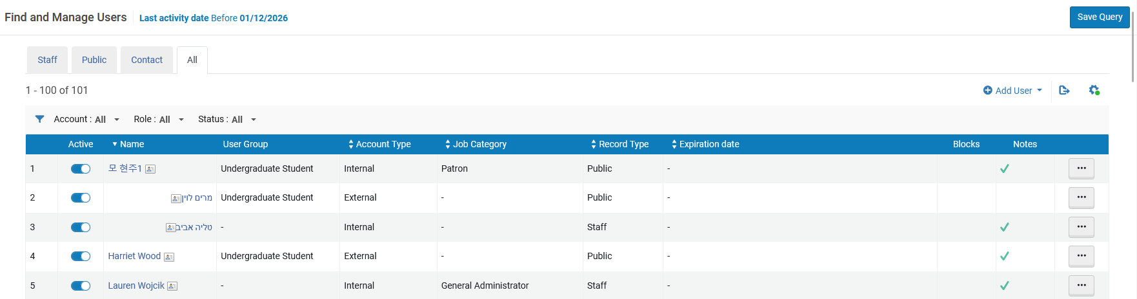
Let's see it live
The results can be saved as a set

Slide 16
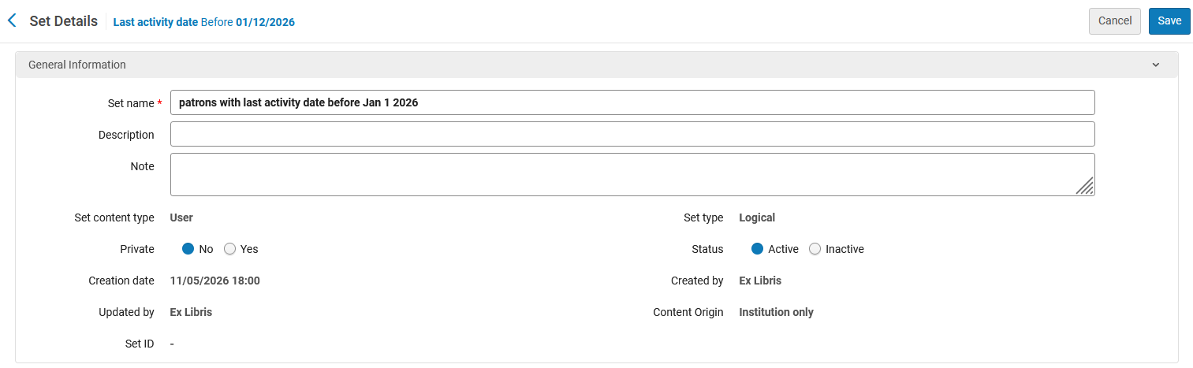
Let's see it live
Here we create and save the set

Slide 17
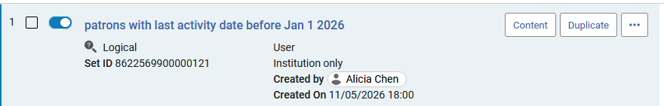
Let's see it live
It is then possible, for example, to run the job "Update / Notify Users" on this set.
One option for example would be to update the purge date for these users to eventually purge them.

Slide 18
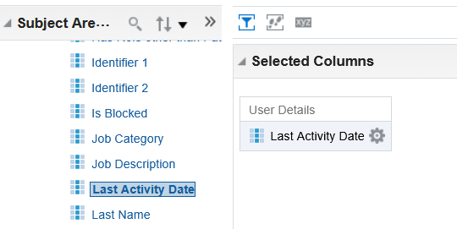
Let's see it live
The Last Activity Date also appears in the "Users" subject area of Alma Analytics, in the "User Details" folder.
Thus, various Alma Analytics reports can be created based on the last activity date.

